Slide 1
Mountain grassland dynamics: integrating phenotypic plasticity in a new agent-based model
Ph.D. defence of
Clément Viguier
realised under the supervision of
Björn Reineking
at IRSTEA Grenoble – LESSEM
Uta Berger
Technische Universitat Dresden
Rapporteur
Marie-Laure Navas
Montpellier SUPAGRO
Rapporteur
Annabel Porte
INRA – Université de Bordeaux
Examinatrice
François Munoz
LECA – Université Grenoble Alpes
Examinateur

Slide 2
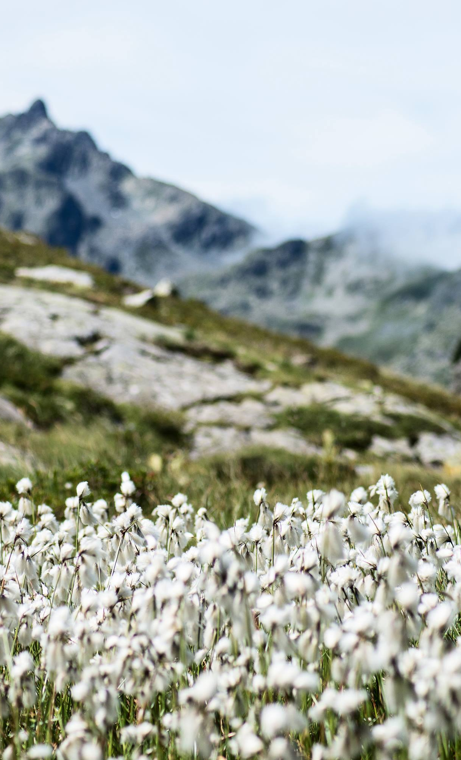
Introduction
1
From context to questions

Slide 3
Mountain grasslands provide services
Flower
production
Various and depends on the properties of the community shape by environmental drivers
Carbon
sequestration
Fodder
productivity

Slide 4
Assessing grassland ecosystem services
Drivers
Community
structure
Summary statistics
Services

Slide 5
Assessing grassland ecosystem services
Drivers
Community
structure
Summary statistics
Services

Slide 6
Assessing grassland ecosystem services
Drivers
Community
structure
Summary statistics
Services

Slide 7
Assessing grassland ecosystem services
Drivers
Community
structure
Summary statistics
Services

Slide 8
Intra-specific variability matters and impacts the community responses
Species
turn-over
Should be considered in:
- ES assessments
Dynamic models
ISV
Jung 2014
Up to 40% of the total variability of some traits.
Strong impact on community response

Slide 9
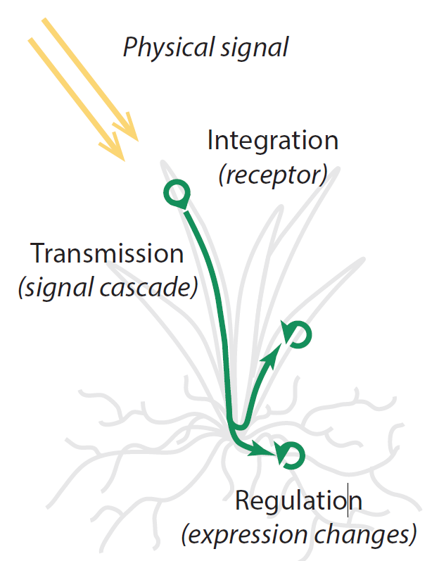
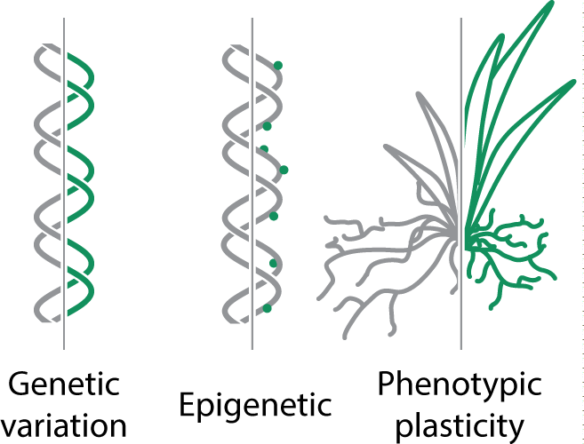
The phenotypic plasticity: one source of variation

Slide 10
The phenotypic plasticity: one source of variation
Rapid response to driver variations
Often overlooked because hard to study in empirical experiments

Slide 11
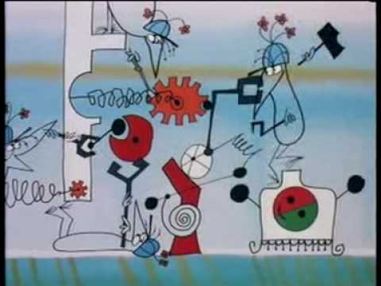
Mechanistic models to understand
Explicit link with drivers
Experiment at low cost

Slide 12
Mechanistic models to understand
Explicit link with drivers
Experiment at low cost
But often limited to a few species or functional types in a discrete manner

Slide 13
How does phenotypic plasticity impact grassland community properties?

Slide 14
How does phenotypic plasticity impact grassland community properties?
Species diversity and dominant strategies

Slide 15
How does phenotypic plasticity impact grassland community properties?
How model diverse plant communities integrating phenotypic plasticity?

Slide 16
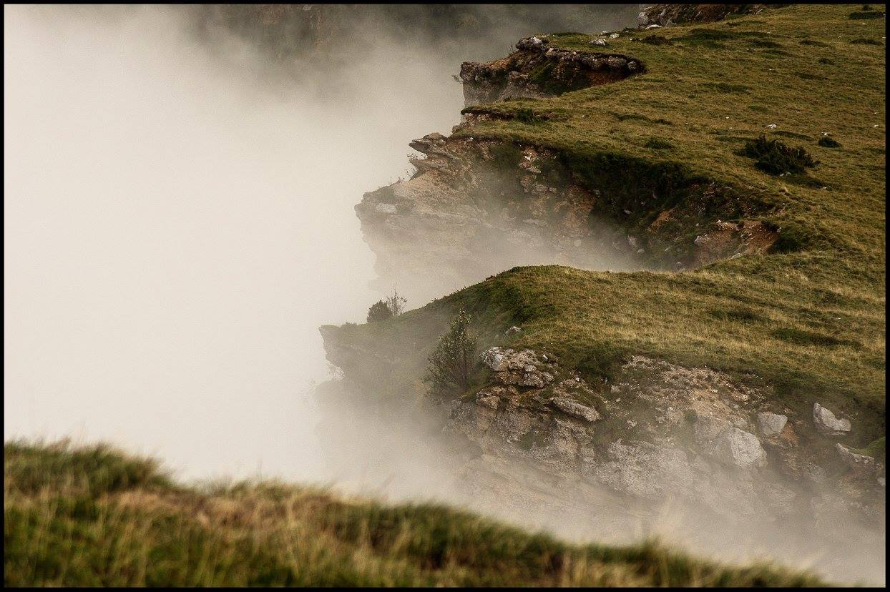
Concepts
2
From ecological concepts to the model MountGrass

Slide 17
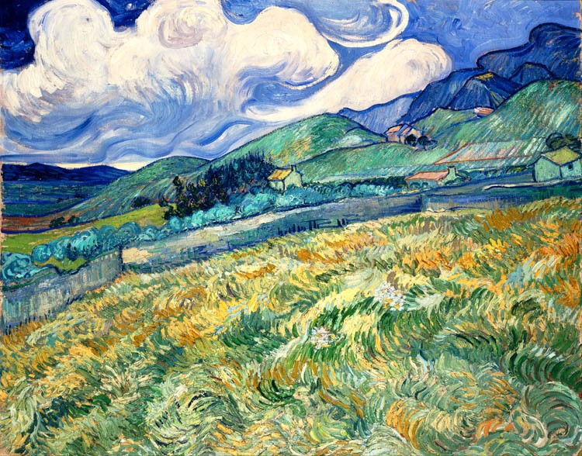
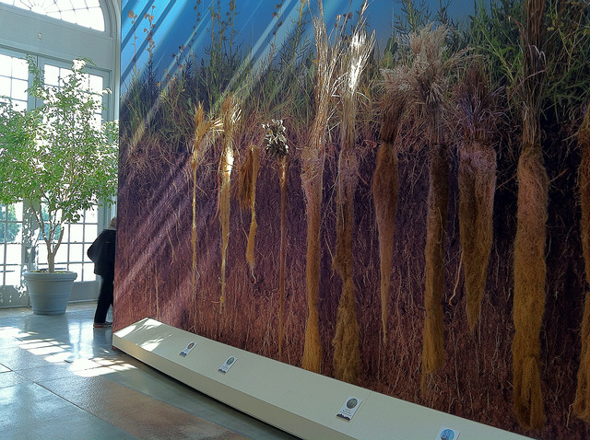
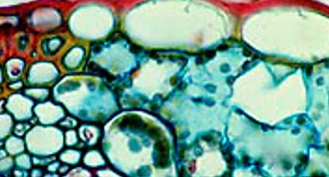
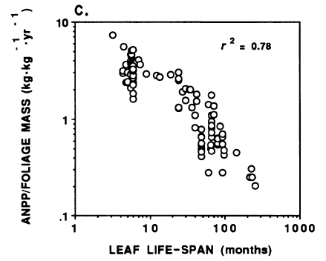
Niche and variability
Competition for resources
Strategy trade-offs
P. Reich (1992)

Slide 18
Niche & variability
Site env. variability
Fit of a species under specific environmental conditions
Variability promotes coexistence
True for spatial and temporal variability
Fitness
Env. gradient
Community

Slide 19
Competition for resources
Fitness
Env. gradient
Main plant interaction mechanism
Shapes communities by affecting the realised niches
Depends on plant strategies

Slide 20
Strategy trade-offs
Leaf Economic Spectrum
Plant strategies are constrained
→ Dimension reduction
Continuum of plant strategies
Build a strategy space
Depends on allocation
P. Reich (1992)

Slide 21
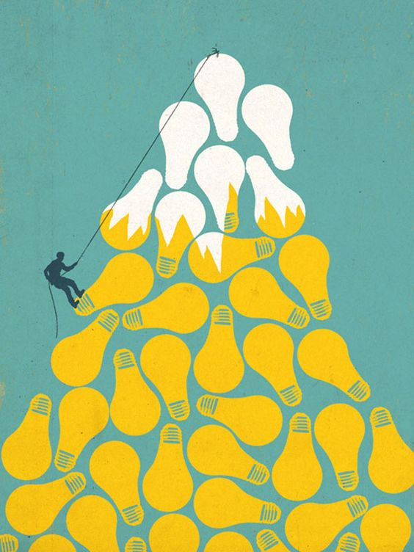
The model MountGrass

Slide 22
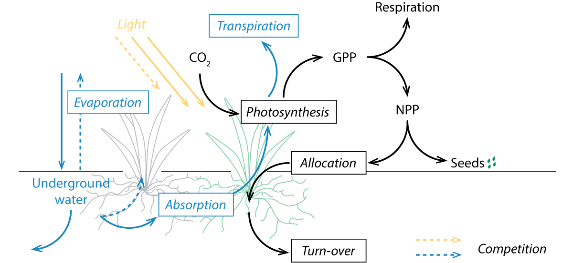
MountGrass’ processes
Response to drivers: physiological processes.
Above and belowground competition: light and water cycles.
Strategies: carbon allocation trade-offs.

Slide 23
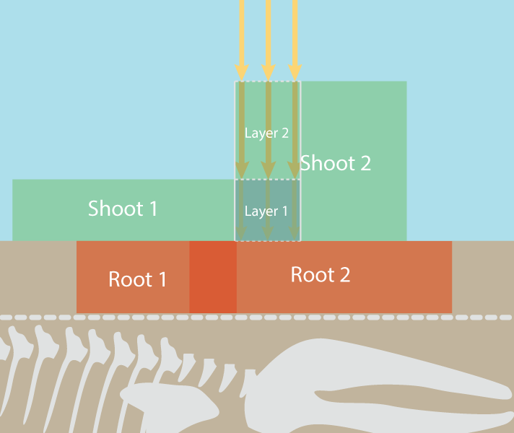
Space & time: the individual plant scale
Individual-based model
spatialy explicit: explicit competittion
1 cm resolution
daily time-step

Slide 24
Plant carbon pools and allocation trade-offs
6 vegetative pools
3 dimensions:
Root:shoot ratio
Prop. active in shoot
Prop. active in root
Allocation trade-offs
→ strategic trade-offs

Slide 25
Allocation trade-off into strategic trade-off
Exploitative
density
lifespan
active
Proportion of active tissues
in shoot (PAS)
Conservatives
structural
area
biomass
respiration

Slide 26
Phenotypes and strategies
PAS
PAR
Root:Shoot

Slide 27
Phenotypes and strategies
Each point is a valid strategy
PAS
PAR
Root:Shoot
→ sample diverse strategies in a continuous space

Slide 28
Phenotypes and strategies
Plasticity allows plant to move within this closed space,
but it needs rules.
PAS
PAR
Root:Shoot

Slide 29
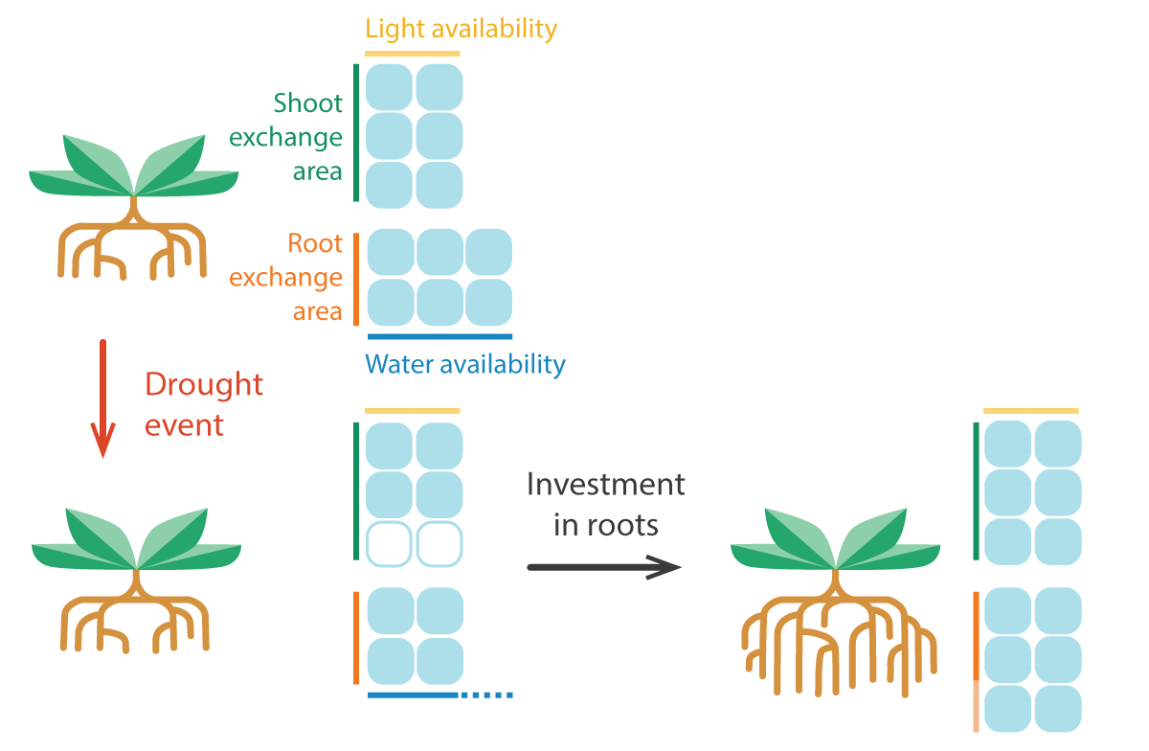
Plasticity: the functional equilibrium
Objective function: root activity = shoot activity
Plastic dimension: Root:Shoot ratio
Assumption: tomorrow same as today
Potential
evapotranspiration
Potential root
absorption
« fixed-equilibrium »
= changes in Root:Shoot only
PAS
Root:Shoot
PAR

Slide 30
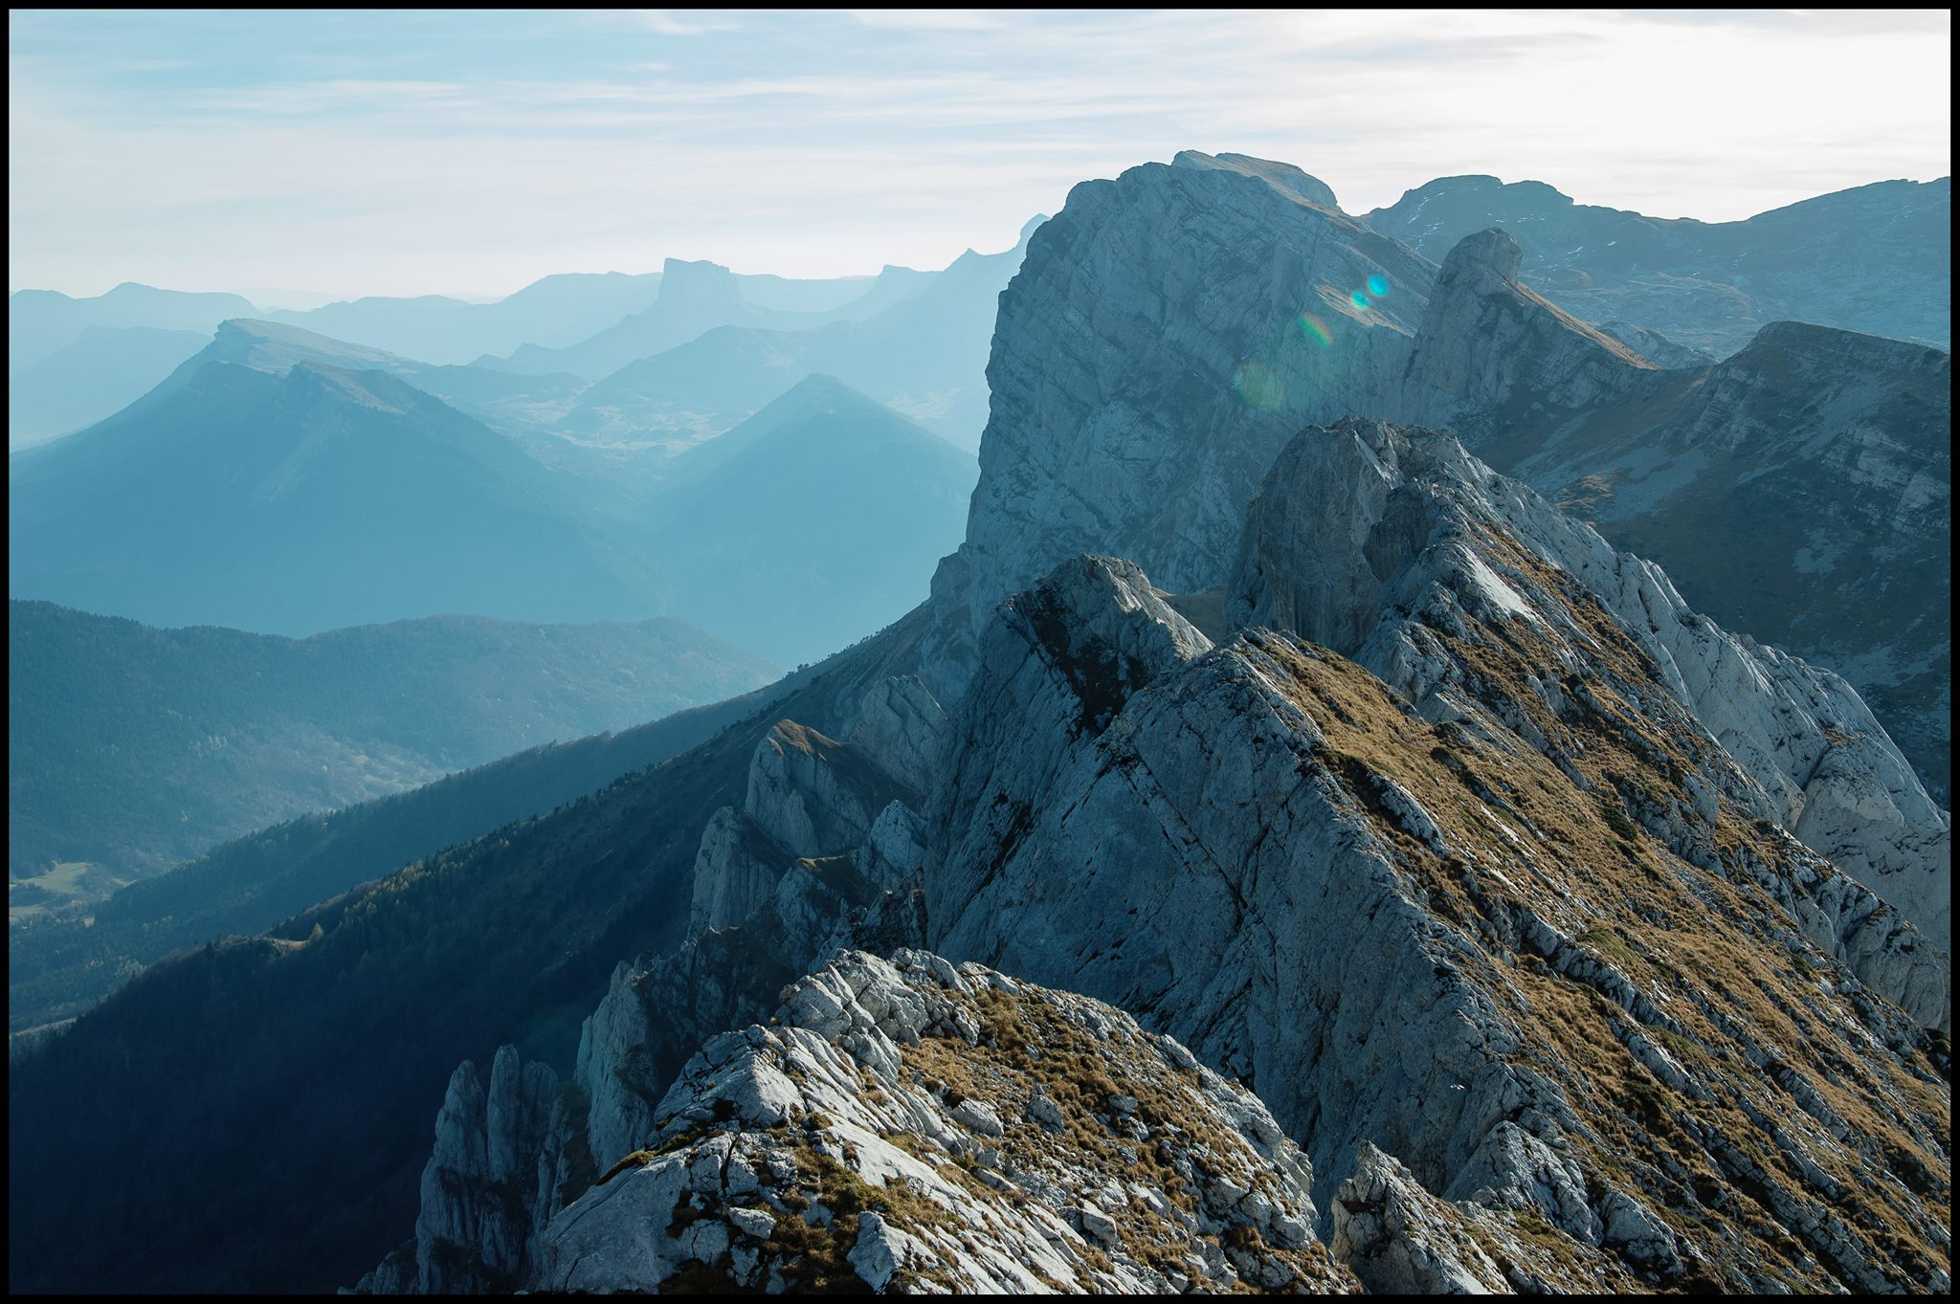
Results
3
Individual- and community-level effects of plasticity

Slide 31

Parameter
filtering
1 parameter set
= 31 values
31 parameters
Pot growth patterns in 2 treatments of watering
→ Selection of a subset of parameter sets for simulations
Accepted sets
Simulation sets
Trend from multiple simulations
111 days
fixed T° & irradiance
12*12*90 cm pots

Slide 32
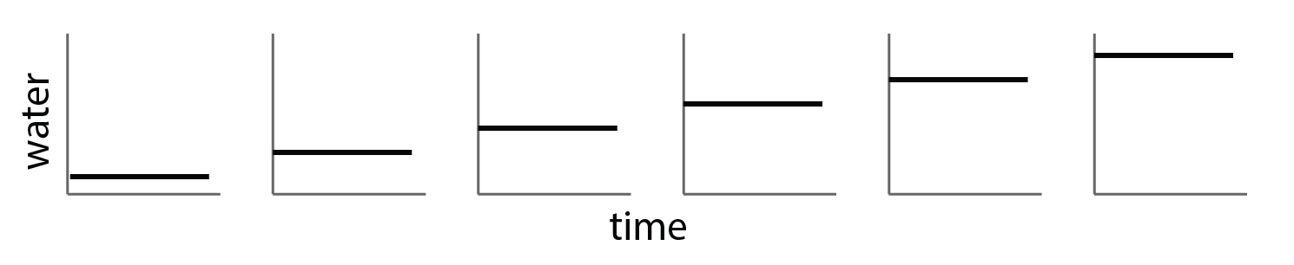
Individual-level simulations
fixed T° & irradiance
12*12*90 cm pots
100 days
How does plasticity affect community response to spatial and temporal variability?
Individual growth along an availability gradient (spatial)

Slide 33
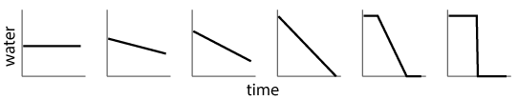
Individual-level simulations
fixed T° & irradiance
12*12*90 cm pots
100 days
How does plasticity affect community response to spatial and temporal variability?
Individual growth along an availability gradient (spatial)
Individual growth along an variability gradient (temporal)

Slide 34
Individual-level simulations
fixed T° & irradiance
12*12*90 cm pots
100 days
How does plasticity affect community response to spatial and temporal variability?
Individual growth along an availability gradient (spatial)
Individual growth along an variability gradient (temporal)
1 resource: water → observe the effect of plasticity on biomass and optimum root strategy (PAR)

Slide 35
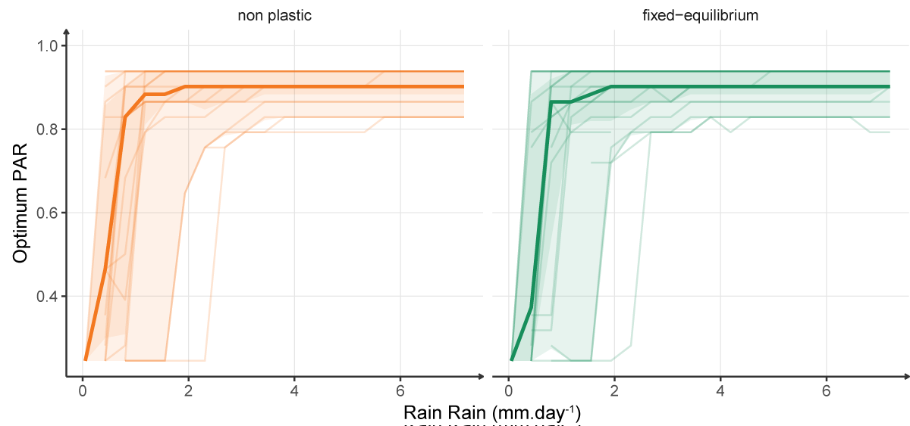
Plasticity effect in homogeneous conditions
Optimum strategy along a water availability gradient
Control
Fitness
Env. gradient

Slide 36
Plasticity effect in homogeneous conditions
Optimum strategy along a water availability gradient
No shift in best strategy
No change in maximum biomass
No shift in the dominant species

Slide 37
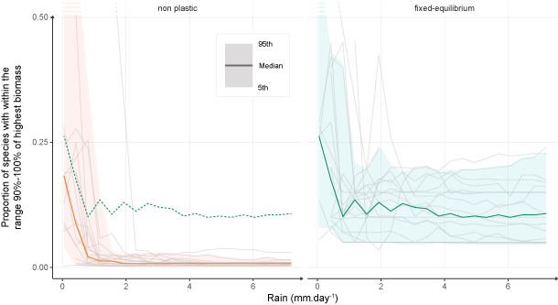
Plasticity effect in homogeneous conditions
Proportion of species with high performances along a water availability gradient

Slide 38
Plasticity effect in homogeneous conditions
Proportion of species with high performances along a water availability gradient
Reduction of growth differences
Niche widening

Slide 39
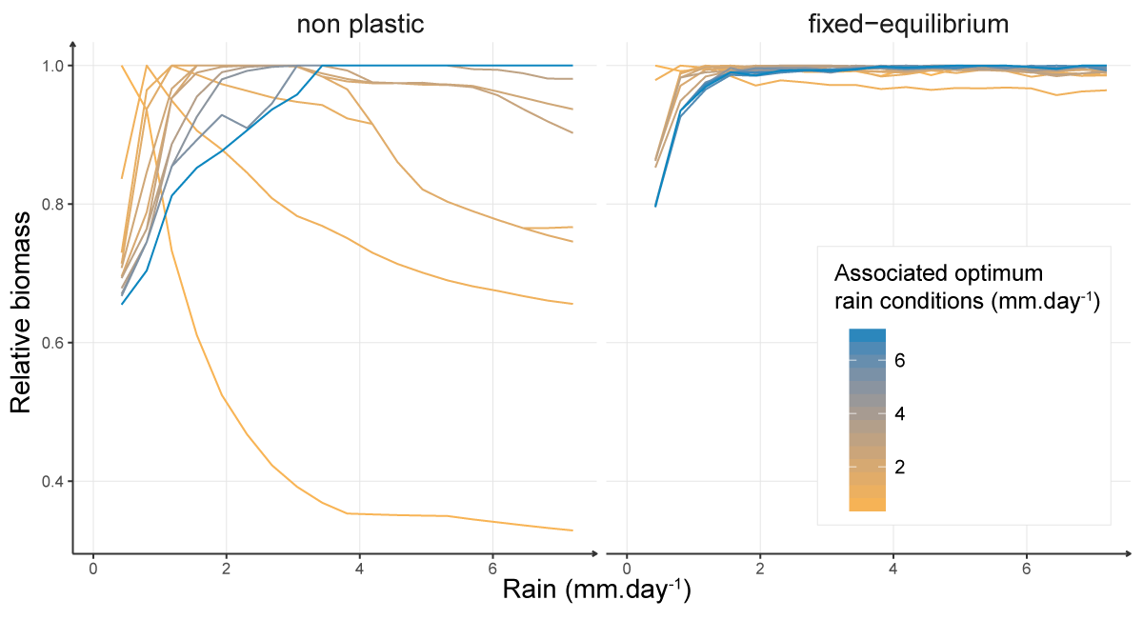
Niche widening in homogeneous conditions
Potential niche of best species
Plasticity
→ increases relative biomass in non optimum conditions
for 1 parameter set

Slide 40
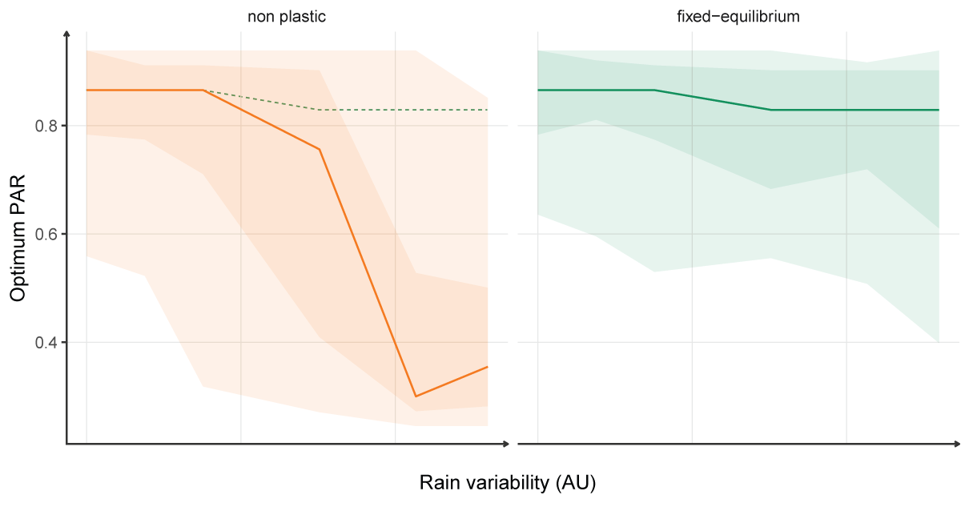
Plasticity effect in heterogeneous conditions
Optimum strategy along a water variability gradient

Slide 41
Plasticity effect in heterogeneous conditions
Optimum strategy along a water variability gradient
Changes in dominant strategy in favour of exploitative species
Reduction of growth differences
Increase of relative BM

Slide 42
Plasticity effect in heterogeneous conditions
Optimum strategy along a water variability gradient
Changes in dominant strategy in favour of exploitative species
Reduction of growth differences
Increase of relative BM
Asymmetric gain (+exploitative strategies)
Niche widening

Slide 43
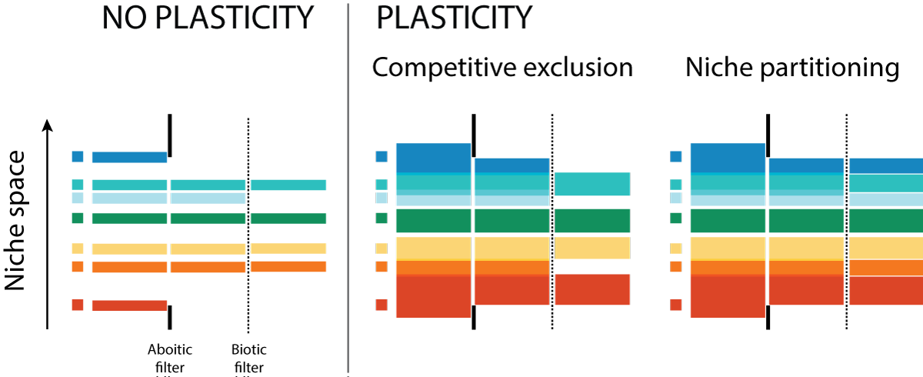
Consequences at the community level ?
Niche widening = reduction of abiotic filtering + reduction of fitness differences

Slide 44
Consequences at the community level ?
Niche widening = reduction of abiotic filtering
higher potential species diversity
Asymmetric gain
Competitive exclusion by exploitative species?

Slide 45
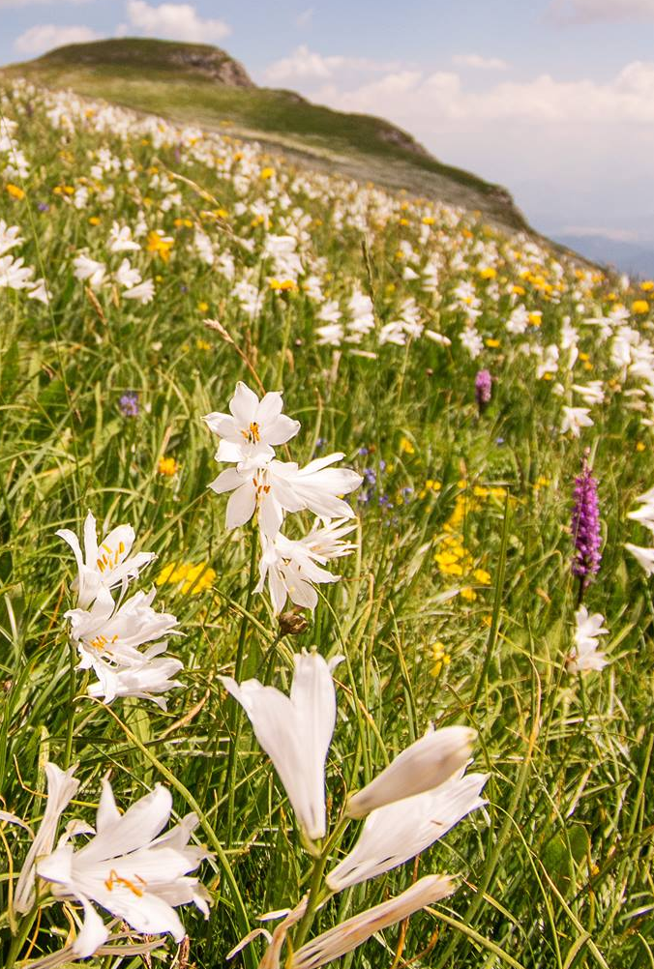
Community-level simulations
Real conditions of variability (weather data for 6 sites) + explicit competitive interactions
Long term simulations (300 years)
12 stable parameter sets (reproducing individual after 50 years in non plastic conditions)
400 different phenotypes
6 sites: meta-community
100*100cm plots
6 sites:
variable T°, prec. & irradiance

Slide 46
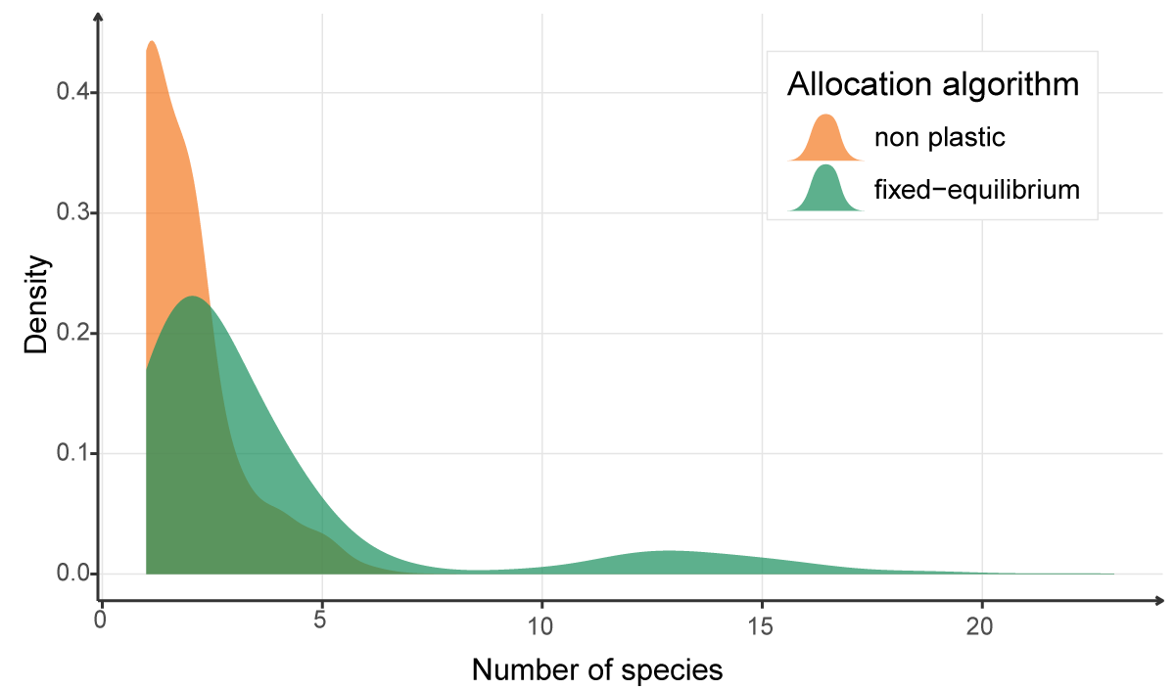
Effects of plasticity on species diversity
Distribution of species diversities of simulated communities
Higher species diversity

Slide 47
Effects of plasticity on species diversity
Distribution of species diversities of simulated communities
Higher species diversity
Niche widening > asymmetric gain
= better niche partitioning

Slide 48
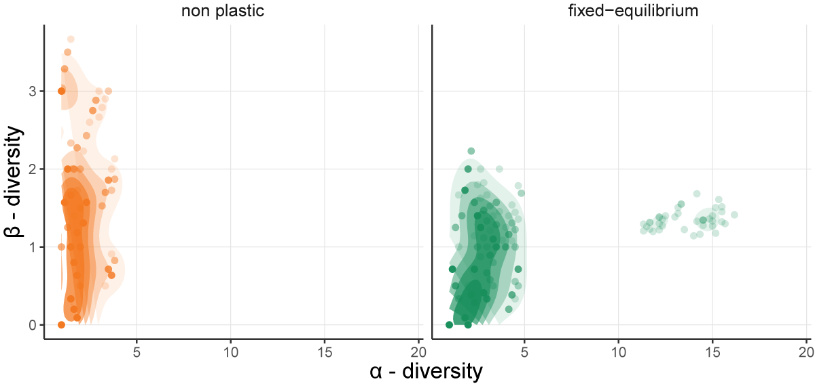
A shift in meta-community structure?
Species diversity structure
Shift in diversity structure:
Less distinct site communities
Richer site communities
Between sites
Within sites

Slide 49
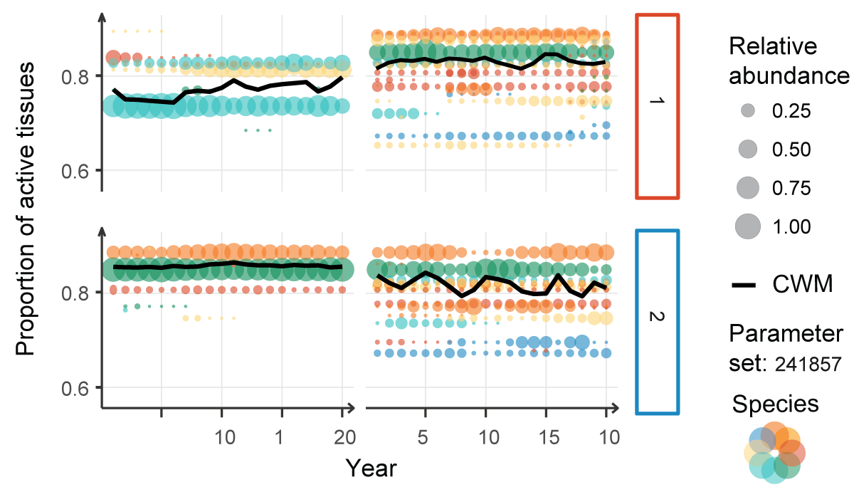
A shift in meta-community structure
More species → abundance variations but no composition shifts
Species diversity structure
Community composition for 2 sites
non plastic
fixed-equilibrium
Between sites
Within sites

Slide 50
A shift in meta-community structure
More species → abundance variations but no composition shifts
Community composition for 2 sites
non plastic
fixed-equilibrium
non plastic
fixed-equilibrium
1
2

Slide 51
Results summary
Niche widening
Assymetric gain in favour of exploitative species = loose of sensitivity to resource variability
Niche widening > asymmetric gain
Plasticity alters meta-community structure
Availability gradient
Variability gradient

Slide 52
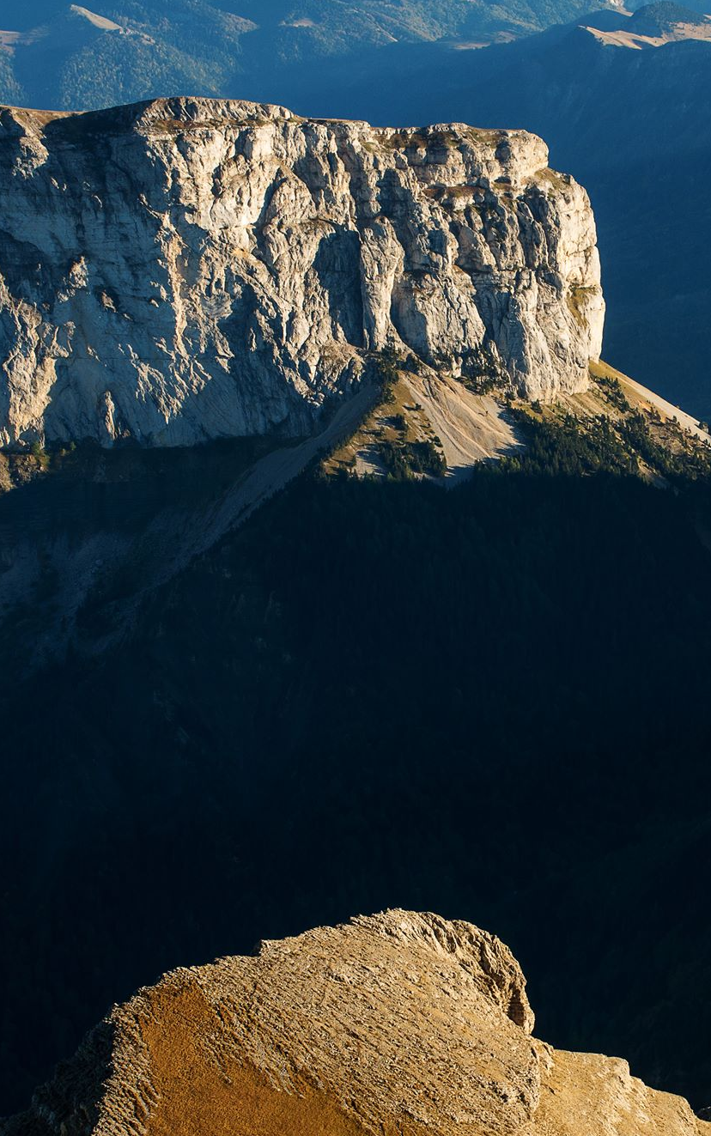
Discussion
4
Impact on community dynamics and community modelling

Slide 53
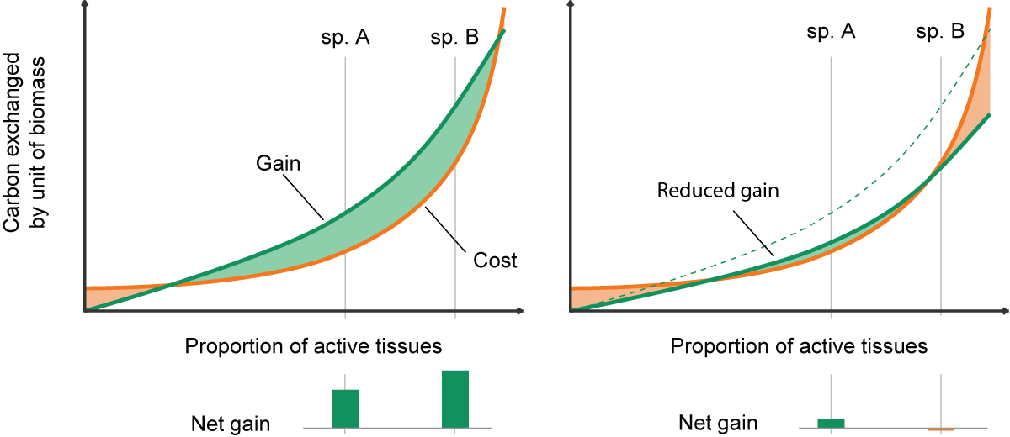
How plasticity favours exploitative species?
Gain & costs as a function of the proportion of active tissues
Exploitive= lower efficiency, but higher exchagne rate
→ Sensitivity to unbalance functioning
Plasticity ensures balance and negates the sensitivity
High resources
Low resources
Plasticity is a process integrated at the scale of the whole individual

Slide 54
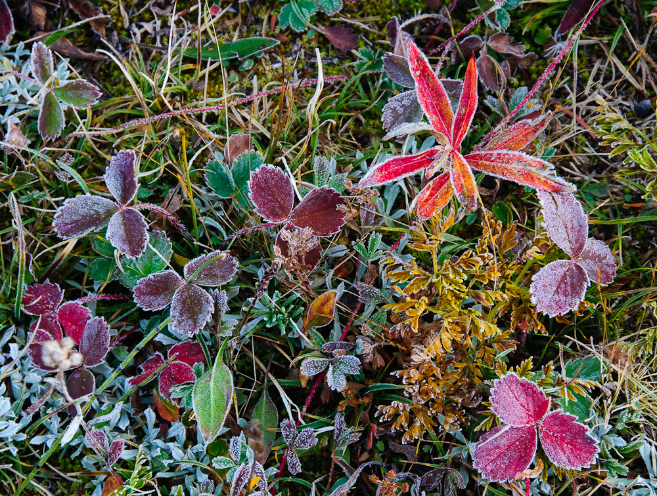
Transfer to real systems?
There is not switch in reality
Is plasticity as important as it seems for diversity?
→ Cost of plasticity
→ Sampling effect
Response to specific disturbances:
- new niche axis;
- asymmetric;
Frost & grazing

Slide 55
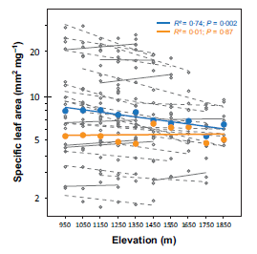
Dialogue between models & empirical experiments
Mean specific trait along an elevation gradient
MODEL
Plasticity as a structuring process
Experiment with multiple scenarios
Plasticity as a trait
EMPIRICAL
Plastic dimensions & responses
Cost of plasticity
Phenotypic flexibility

Slide 56
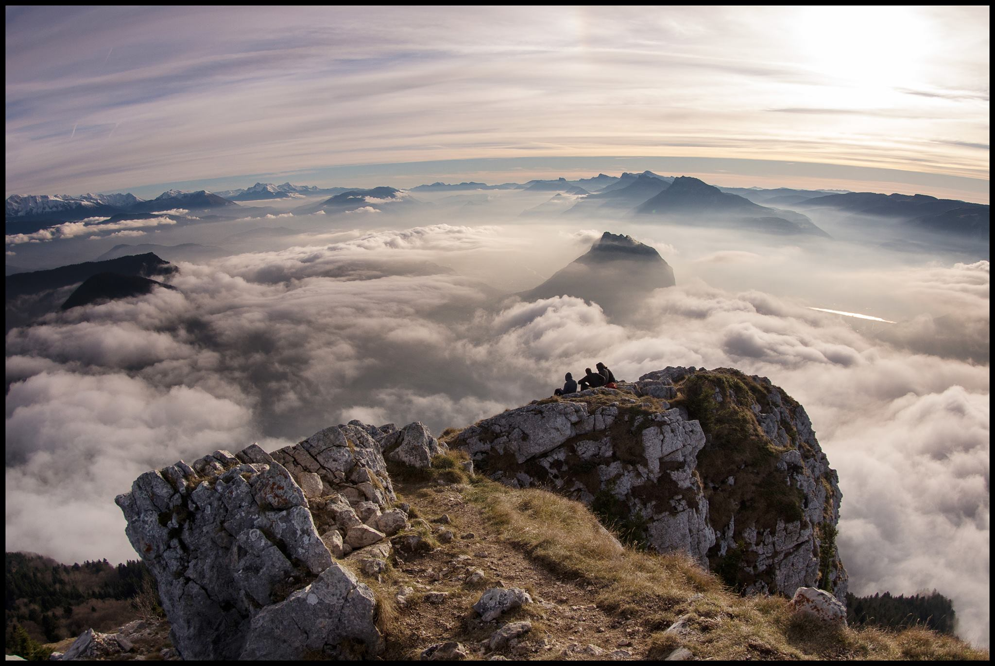
Conclusions & Outlook
5
A consistent framework for a better understanding of plasticity

Slide 57
Modelling conclusions:
A diverse community framework
Diversity in strategies and species
Plasticity in coherent framework
Plasticity as a strategy (not explored)
but…
Reduce the number of parameter sets & stabilise the species
High functional convergence

Slide 58
Ecological conclusions:
A better undertanding of plasticity
Better understanding as an integrated growth process not just a response function
Plasticity impacts diversity via multiple mechanism at multiple scales
Plasticity is rarely symmetric (niche widening promotes subordinates species, assymetric gain favours certain strategies)

Slide 59
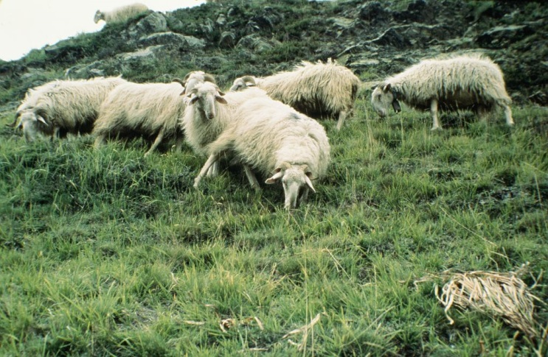
To go beyond
Better calibration and strategy sampling to confirm results
Climat, management and perturbation scenarios
Explore the plasticity as a strategy

Slide 60
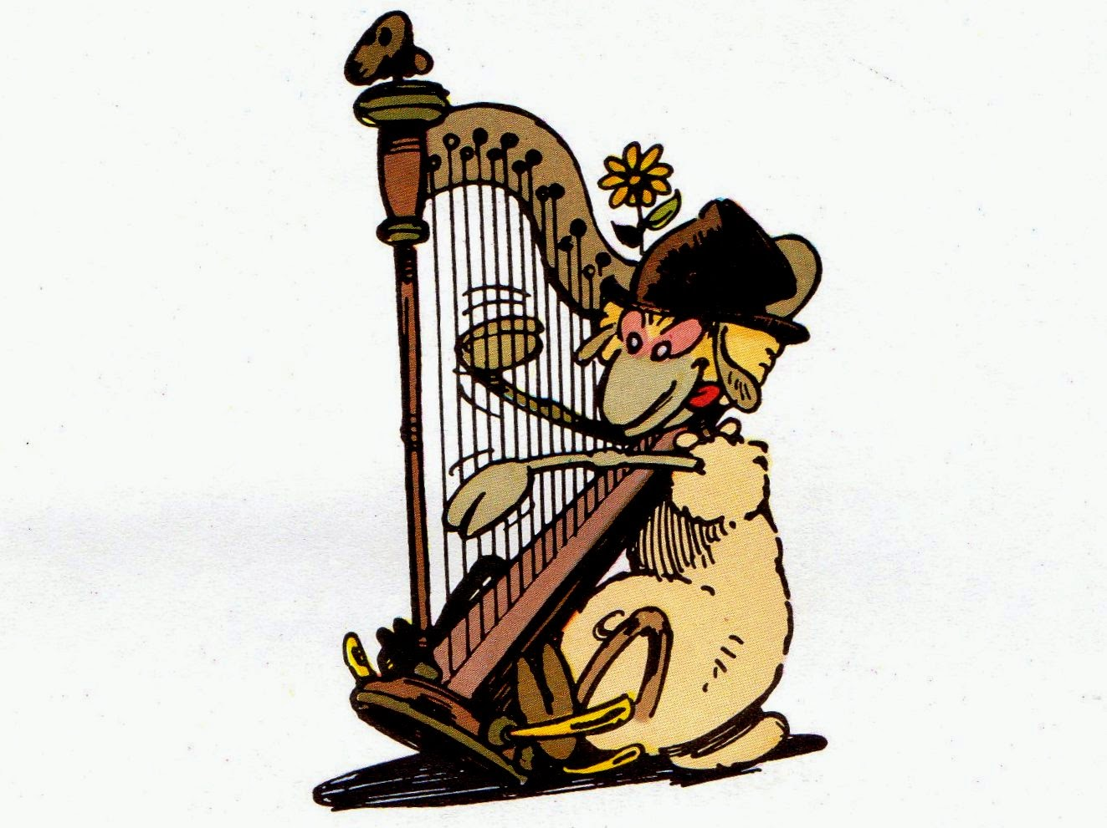
Thank you!
Merci pour votre attention.
Et merci pour l’accueil, l’aide, les rires, les discussions, les explications, les encouragements, les sorties terrains, les relectures, les photos, les pauses, les blagues, la motivation, le soutien, les distractions, les présentations, les pots, les mots gentils…
Merci !

Slide 61
Bonus!

